Slide 1

Topics Covered in Today’s Lecture
Machine Learning in the Context of Artificial Intelligence (AI)
The Connectionists: Artificial Neural Networks (ANN’s), Machine Learning (ML) and Deep Learning (NN)
Three Pillars of Machine Learning: Data, Algorithms & Processing Power
Machine Learning Today: Progress, State-of-the-Art & Challenges

Slide 2
Part A
Machine Learning in the Context of
Artificial Intelligence (AI)

Slide 3



What is Machine Learning?
“… a field of study that gives computers the ability to learn without being explicitly programmed”
(- Arthur Samuel, 1959)
“… the study of computer algorithms that allow computer programs to automatically improve through experience”
(- Tom Mitchell, 1997)
Artificial Intelligence
Completing tasks which normally require human level intelligence
Machine Learning
Statistical methods enabling machines improve with experience
Deep Learning
Many-layered learning- networks progressively extracting higher level features from raw input
If you want to learn more about ML, check out the
really excellent online lectures by Andrew Ng*
* https://www.youtube.com/playlist?list=PLLssT5z_DsK-h9vYZkQkYNWcItqhlRJLN

Slide 4
A Brief History of AI / ML
1950 | 1960 | 1970 | 1980 | 1990 | 2000 | 2010 | 2020 | 2030
Rules Based AI
?
?
?
?
?
?
?
Symbolic Logic & Reasoning
Birth
of AI
Expert Systems (Knowledge Representation)
The Subsumption Architecture
Neuro-Symbolic
Connectionist AI ► The Perceptron ► The Multilayer Perceptron
Neural Networks (NNs) Back-Propagation
Recurrent NNs & LSTM
Deep Learning
Deep-Reinforcement
Other Statistical Learning
Reinforcement Learning
Bayesian Networks & Reasoning under uncertainty
Decision Trees & Random Forests
Support Vector Machines
The Golden Age of AI
1st AI Winter
2nd AI Winter
Broadband / Big-Data / Big-Compute

Slide 5
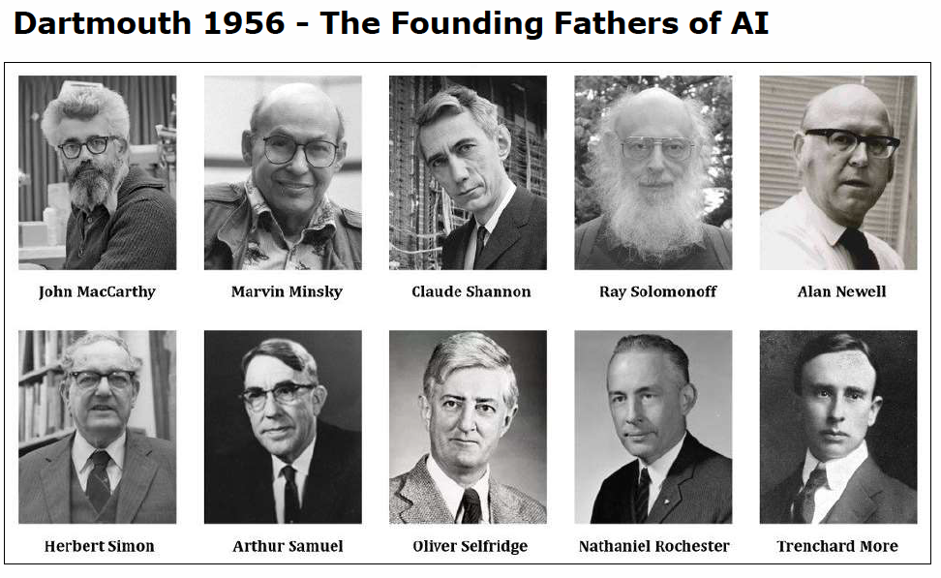
The Origins of AI
1945 | Worlds first programmable computer: ENIAC
1950 | Alan Turing: The Turing Test. Can a machine pass itself off as a human in its responses?
1956 | Dartmouth conference: official birth of AI
1960’s | The Golden Years: Interpret the human brain as a machine
“The study [of AI] is to proceed on the basis of conjecture that every aspect of learning or any other feature of intelligence can be so precisely described that a machine can be made to simulate it”
https://medium.com/rla-academy/dartmouth-workshop-the-birthplace-of-ai-34c533afe992

Slide 6
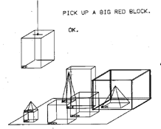
The Golden Years: Logic & Reasoning
1956 | Newell & Simon : 38 Proofs from Pinicipia Mathematica
1963 | DARPA gives MIT $2.2M for machine aided cognition
1964 | IBM Handwriting Recognition Demo at NY World Fair Write Date → Get Headlines Translate English Russian texts
1967 | Marvin Minsky: “Within a generation, the problem of creating AI will substantially be solved”
1970 | Terry Winnograd (MIT): Natural language processing for moving blocks in a Microworld
http://hci.stanford.edu/~winograd/shrdlu/

Slide 7
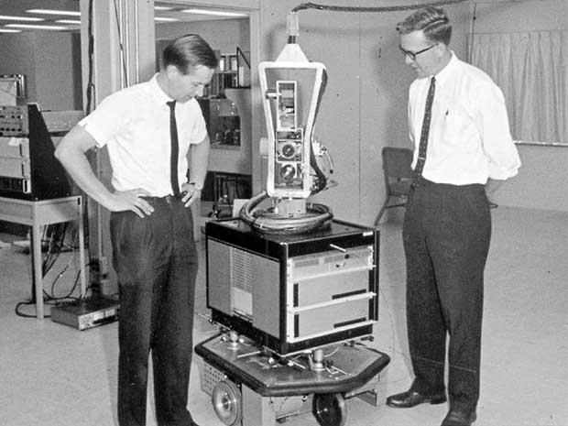
The First AI Winter
1970 | Minsky: In 3-8 years we will have a machine with the general intelligence of an average human
70-73 | AI mainly based on rule-based programming, fails to deliver on most promises
1973 | U.S. and British Governments stop funding undirected AI research
74-80 | The first AI Winter
Shakey, the First “Intelligent” Robot
The Stanford Research Institute 1966-1972
Moravec Paradox: ”It is easy to make computers exhibit adult level performance on intelligence tests or playing checkers, and difficult or impossible to give them the skills of a one-year-old when it comes to perception and mobility”
https://thenewstack.io/remembering-shakey-first-intelligent-robot/

Slide 8
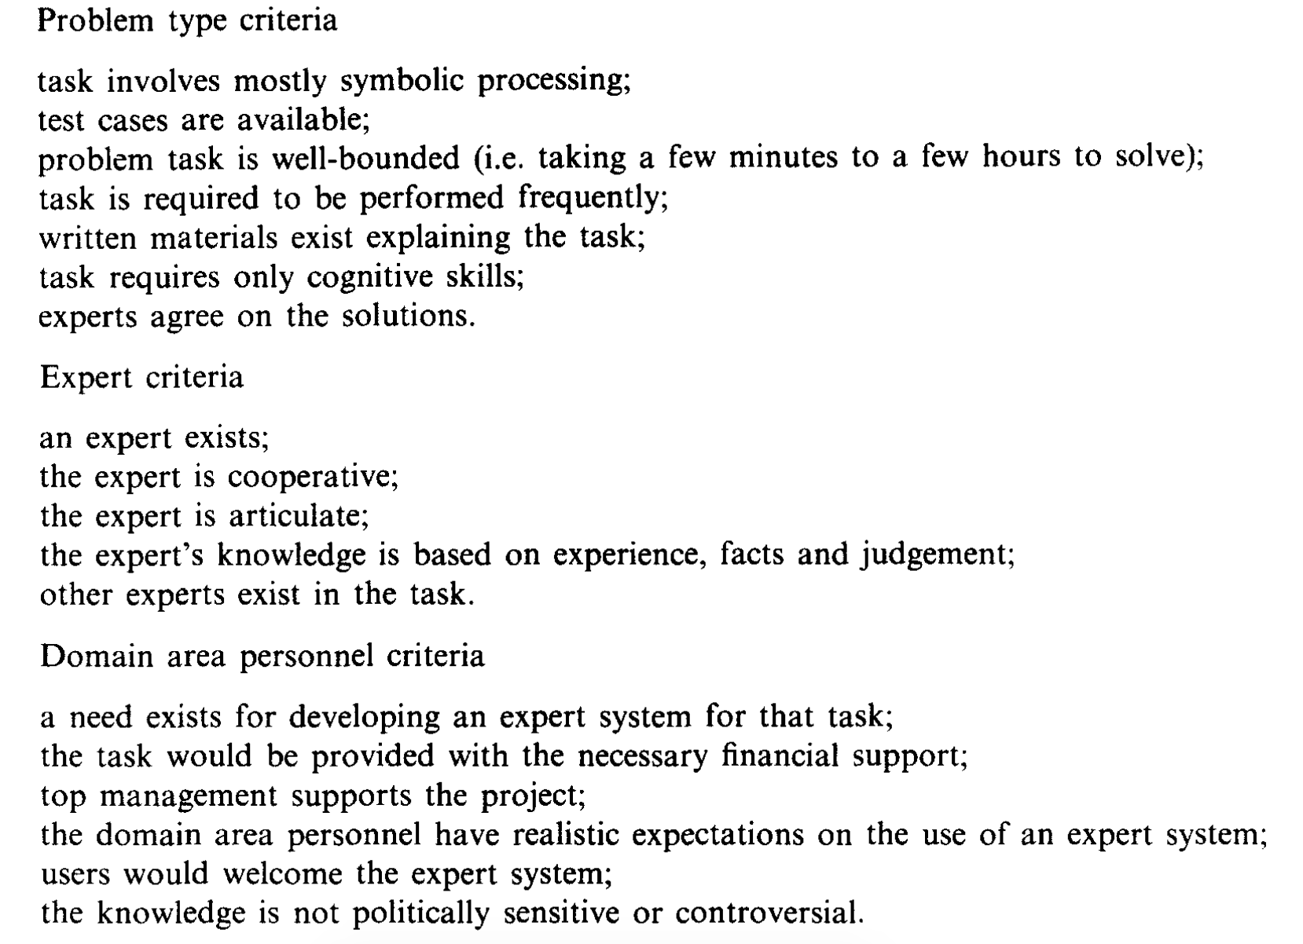
The Second Wave: Expert Systems
1970’s | Research on Expert Systems which augments reasoning with Knowledge
1980’s | Large-scale deployment: Two thirds of Fortune 500 companies used the technology in daily business.
1985 | Over $1B Spent on AI research & development by more than 150 companies
Expert Systems: Success Criteria
“Expert Systems: A Short Introduction”, Jay Liebowitz, 1995, Engineering Fracture Mechanics

Slide 9
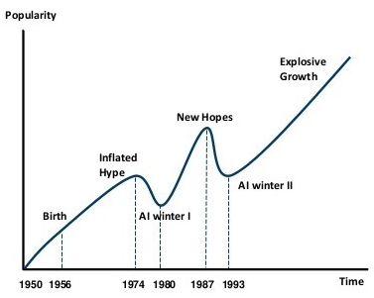
The Second AI Winter
“AI Winters”
1987 | Collapse of market for specialized AI hardware (LISP Machines)
87-89 | DARPA Funding Slashed by one third
89-92 | Most deployed systems fall into disuse
Steven Pinker “The main lesson of the first 35 years of AI research is that the hard problems are easy and the easy problems are hard”
https://www.actuaries.digital/2018/09/05/history-of-ai-winters/
“Early Expert Sytems, Where are they Now?” T.G. Gill, MIS Quarterly, 1995

Slide 10
Part B
The Connectionists:
Artificial Neural Networks (ANN’s),
Machine Learning (ML) and Deep Learning (NN)

Slide 11

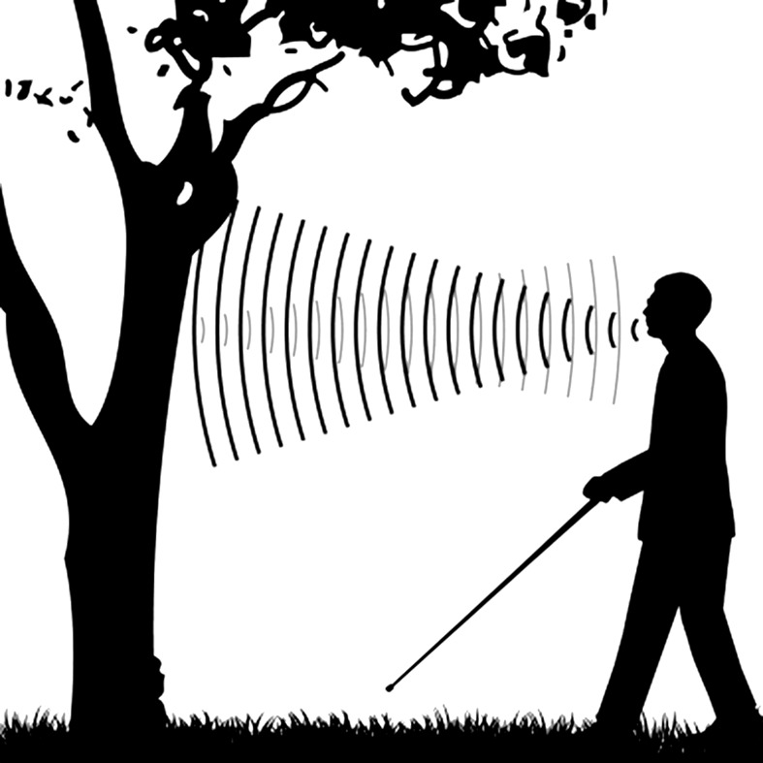
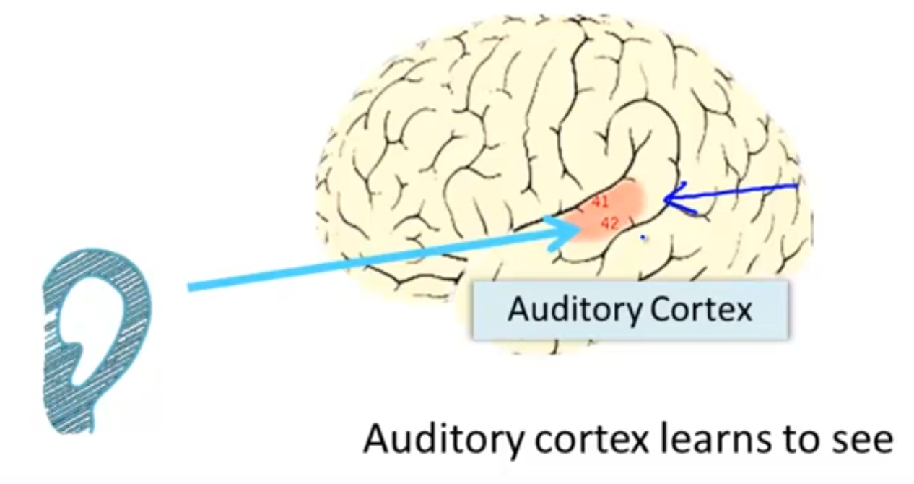
How do Humans and Animals Learn?
There is a hypothesis that there is one type of learning, used by every part of the brain
Example: in animal experiments, when optic nerves are connected to the auditory cortex: the animal learns to see!
Example: In 1848 Phinneas Gage had a 3-foot rod go through his cheekbone and out the top of his skull. He lived another 11 years and learned to adapt to his condition.
Example: Some blind people learn to echolocate like bats, making clicks with their mouths.
Can we explain learning by examining structures in the brain?
https://www.wpr.org/how-phineas-gages-freak-accident-changed-brain-science
https://www.newscientist.com/article/2145962-this-is-how-some-blind-people-are-able-to-echolocate-like-bats/#ixzz6b9VWpdHW

Slide 12
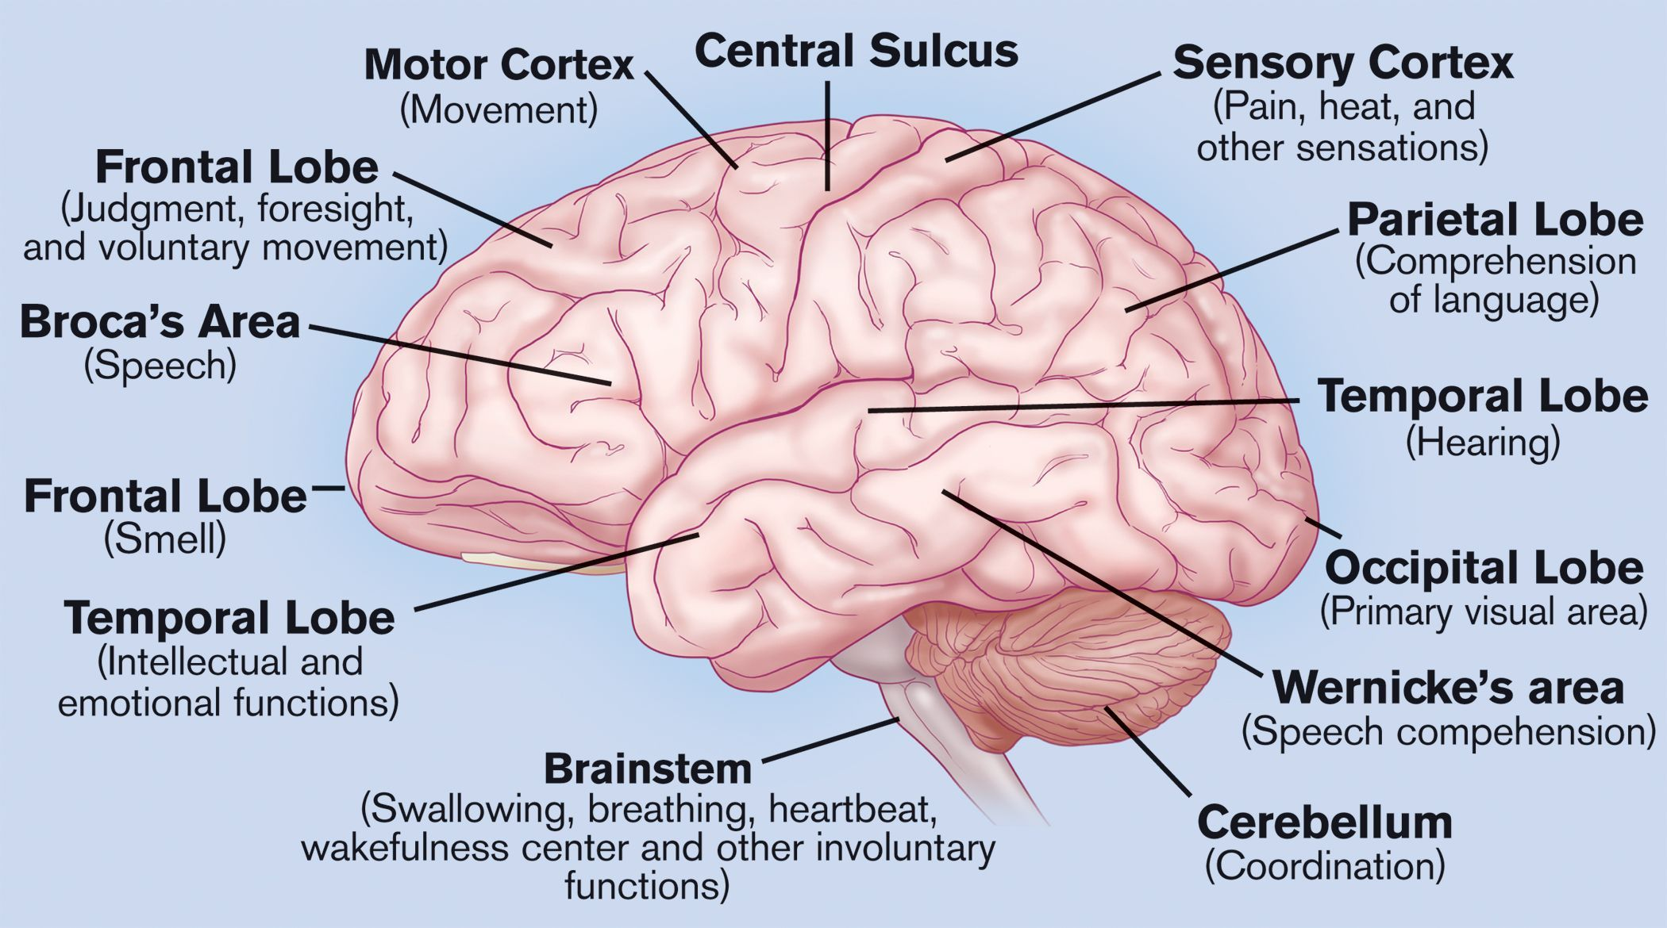
The Human Brain
Weight:
1.3 – 1.5kg
Neurons:
~100 Billion (~10¹¹)
Connections:~150 Trillion (~10¹⁴)
Connectivity:
Each neuron connects to 1k-10k others
All parts of the brain are made of the same neural tissue. It is a highly connected network. The original Connectionists believed that this was at the center of human learning and intelligence and they set out to copy it within computers.
https://youtu.be/m3U1_Zv4_Ik

Slide 13
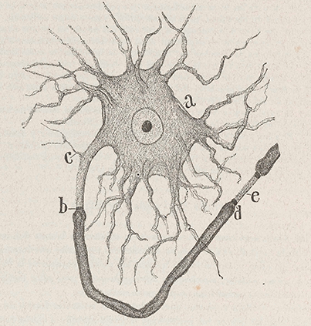
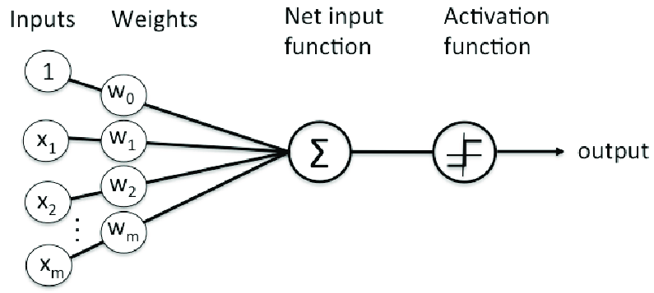
Networks that Learn
1887 | Santiago Ramón y Cajal at Uni. Barcelona discovers neurons as fundamental to the nervous system
1943 | McCulloch & Pitts model the neuron as a logic unit. Show that network of such neurons can do any computation.
1949 | Donald Hebb conceives an update Rule for learning: Neurons that fire together, wire together.
1958 | Frank Rosenblatt takes the ideas into computer research: he invents the Perceptron, a single layer neural network
Cajal’s sketch of a Neuron
Rosenblatt’s Perceptron
https://www.brainfacts.org/brain-anatomy-and-function/cells-and-circuits/2018/santiago-ramon-y-cajal-the-first-modern-neuroscientist
https://vitalflux.com/java-implementation-for-rosenblatt-perceptron/

Slide 14
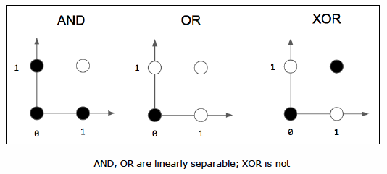
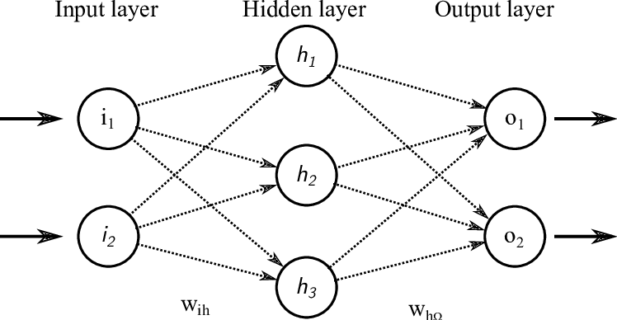
The Difficult Birth of Neural Networks
1969 | Minsky & Papert claim much scientific writing on Perceptrons is without scientific value
70’s | Rosenblatt dies. Rule-based programming dominates. Funding crashes. First AI-Winter.
80’s | Neural networks show promise and make comeback. By ‘91 there are >10k NN researchers in the U.S. alone.
1987 | Yann LeCun proposes modern form of back-propagation learning algorithm for ANNs
1993 | The Second AI Winter! ☹
The perceptron is a supervised binary linear classifier. Can you separate two groups using a straight line?
Neural networks with hidden layers can implement non-linear classification

Slide 15
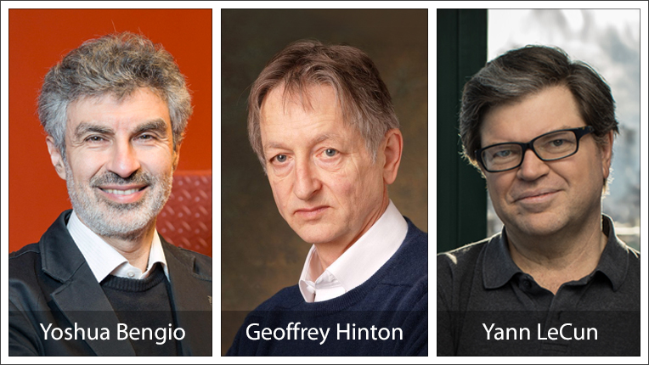
Deep Learning and the AI Boom
2005 | Geoffry Hinton exposes internal function of multi-layered Neural networks with many hidden units
2010 | Affordable GPUs give boost to large Neural Networks
2015 | Machines outperform humans at image recognition. Facebook launches DeepFace (9 layers, 120M params)
2016 | AlphaGo from DeepMind beats world champion Lee Sodol at Go
2020 | Open-AI releases GPT-3 language model with 175 Billion parameters
Turing Award 2018
Key Contribution:
Generative
Adversarial
Networks
Key Contribution:
Backpropagation allows NNs discover their own internal representations of data
Key Contribution:
Convolutional Neural Networks
https://awards.acm.org/about/2018-turing
“Artificial Intelligence in the 21st Century”, Kong et al., IEEE Acess, 2018

Slide 16
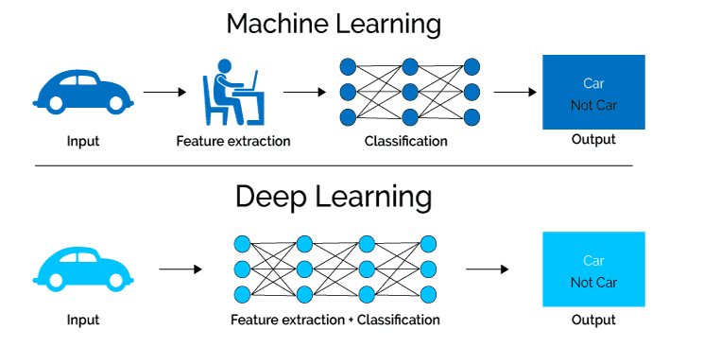
Deep Learning Using Many Layers
The core idea of deep learning is to exploit the ability of large neural networks to learn features within the data relevant to the task at hand
To do this we need lots of data, sophisticated
algorithms and lots of processing power
https://medium.com/@kuzuryu71/deep-learning-vs-machine-learning-7db5cfd75321

Slide 17
PART C
Three Pillars of Machine Learning:
Data, Algorithms & Processing Power

Slide 18
How Much Data is Generated Every Day?
100 Million Uploads to Instagram
500 Million Tweets on Twitter
3.5 Billion Photos Taken
5 Billion Web Searches
65 Billion Messages on Whatsapp
300 Billion Emails
This is mostly well known consumer data. There are also vast amounts of business data being captured in digitalization programs and other public data being captured by government agencies.
Machine learning algorithms can be trained to higher performance levels with labelled data.
This is more expensive, and far more scarce than typical unstructured and unlabeled data
But large, open-source, labelled data sets are available…
https://www.weforum.org/agenda/2019/04/how-much-data-is-generated-each-day-cf4bddf29f/

Slide 19


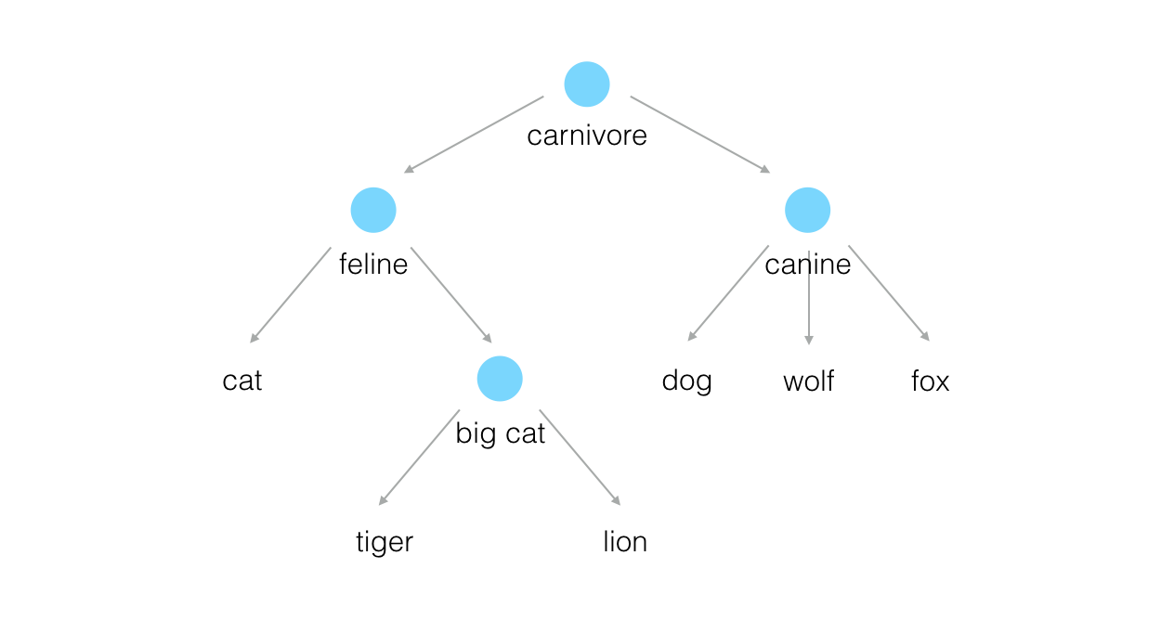
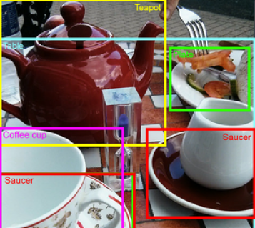

Example: Open Source Image Data
ImageNet
Coco Dataset
Open Images
Biggest and best known, out of Stanford
14M labelled images
1 Million images with bounding box notations
22k image categories, arranged by hierarchy
Common Objects in Context: backed by Microsoft and Facebook
A large-scale object detection, segmentation, and captioning dataset
~200k labelled images
Released by Google
~9M labelled images
object bounding boxes
object segmentation
visual relationships
https://zbigatron.com/the-top-image-datasets/

Slide 20




Open Source Algorithms Are Also Available
Tensorflow
Pytorch
Sonnet
Keras
Google’s TensorFlow is JavaScript-based and comes equipped with a wide range of tools and community resources that facilitate easy training and deploying Deep Learning
Open-source DL framework from Facebook. Designed to speed process from prototyping to production. It has a C++ frontend atop a Python interface
Developed by DeepMind, Sonnet is a high-level library designed for building complex neural network structures in TensorFlow.
Keras is fast and open source!. It can process massive volumes of data while accelerating the training time for models. Provides a Python interface to the TensorFlow library.
There are many more frameworks. It’s worth to check around depending on the needs of your project.
https://www.upgrad.com/blog/top-deep-learning-frameworks/

Slide 21
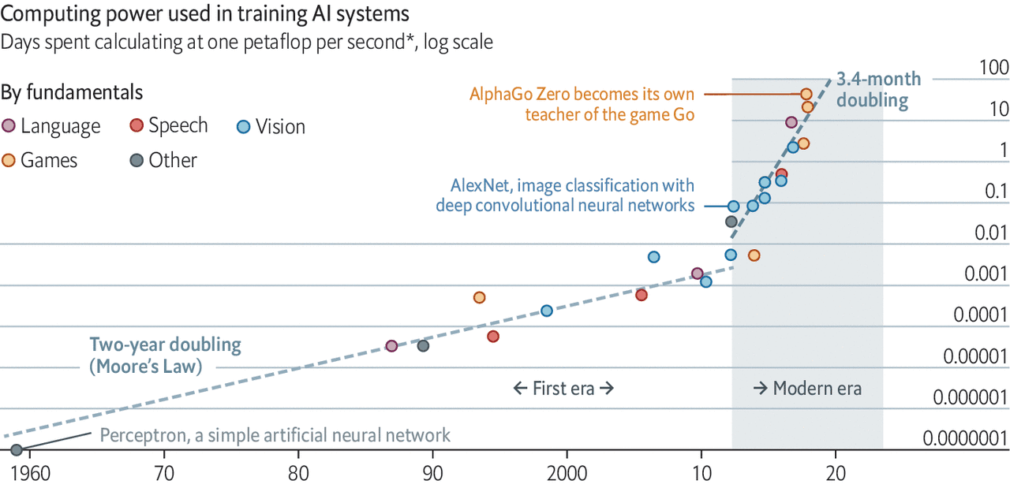
Deep Learning is Hungry for Computation
https://www.economist.com/technology-quarterly/2020/06/11/the-cost-of-training-machines-is-becoming-a-problem

Slide 22
Luckily we have Moore’s Law
Moore's law is the observation that the number of transistors in a dense integrated circuit (IC) doubles about every two years.
https://en.wikipedia.org/wiki/Moore%27s_law

Slide 23
Various Options for Hardware Acceleration
CPU
GPU
FPGA
ASIC
A Central Processing Unit is what you will find in your laptop or PC. General purpose, not so efficient.
E.g. Intel
Graphics Processing Unit, well suited for tensor calculations found in neural nets. Widely used.
E.g. NVidia
Field programmable gate array. Expensive to program, but lightning fast! Worth it for some applications.
E.g. Xilinx
Application specific integrated circuit. Dedicated silicon. Can’t be beaten for speed. Very costly!
E.g. Google TPU
Development Time
Quick and cheap
Long and expensive
Execution Time
Long! Runs more slowly
Short! Runs very fast

Slide 24
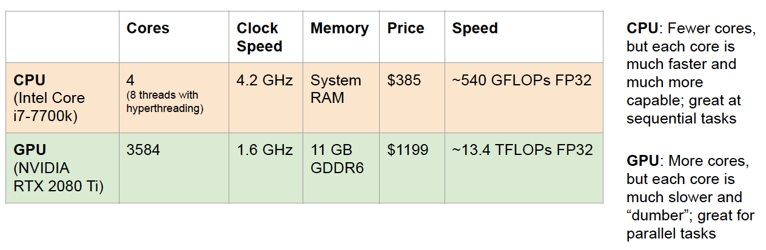
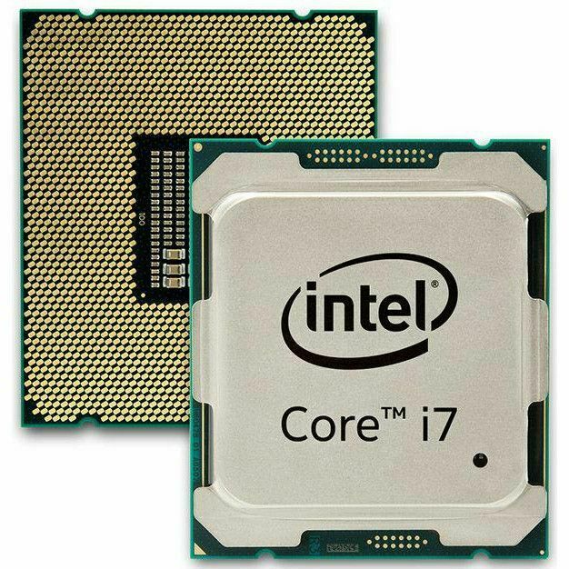
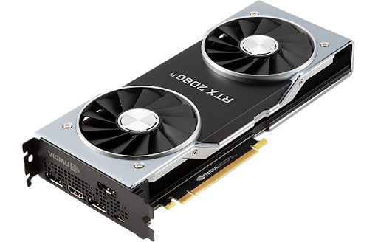
Graphics Processing Units (GPU’s)
VS.
http://vision.stanford.edu/teaching.html

Slide 25




Processing Power Available in the Cloud
Colab
AWS
Azure
IBM Cloud
Google Colab allows you to write and execute Python in your browser with
zero configuration, free access to GPUs, and easy sharing
Amazon Web Services enables deep learning in the cloud at scale. You can quickly train custom AI models, with new algorithms.
GPUs are now part of Microsoft's cloud platform, ideal for the neural networks underpinning much of modern machine learning
IBM Cloud offers GPUs on bare metal and virtual servers. Design and deploy neural networks at scale within IBM Watson Studio
Quick and cheap
The international cloud computing landscape is highly dynamic and changing rapidly.
Switzerland has its own national providers such as Switch.ch for universities
Long! Runs more slowly
Short! Runs very fast

Slide 26

Part D
Machine Learning Today:
Progress, State-of-the-Art & Challenges
Informatik
The aesthetics of Midjourney 5 #AIArt
https://twitter.com/LinusEkenstam/status/1636127055711461377
AI made this and it's NOT midjourney
https://twitter.com/LinusEkenstam/status/1619480963196792833

Slide 27

Artificial intelligence is…
the ability of machines to complete tasks …
which normally require a human level of intelligence… better faster and cheaper than humans can

Slide 28
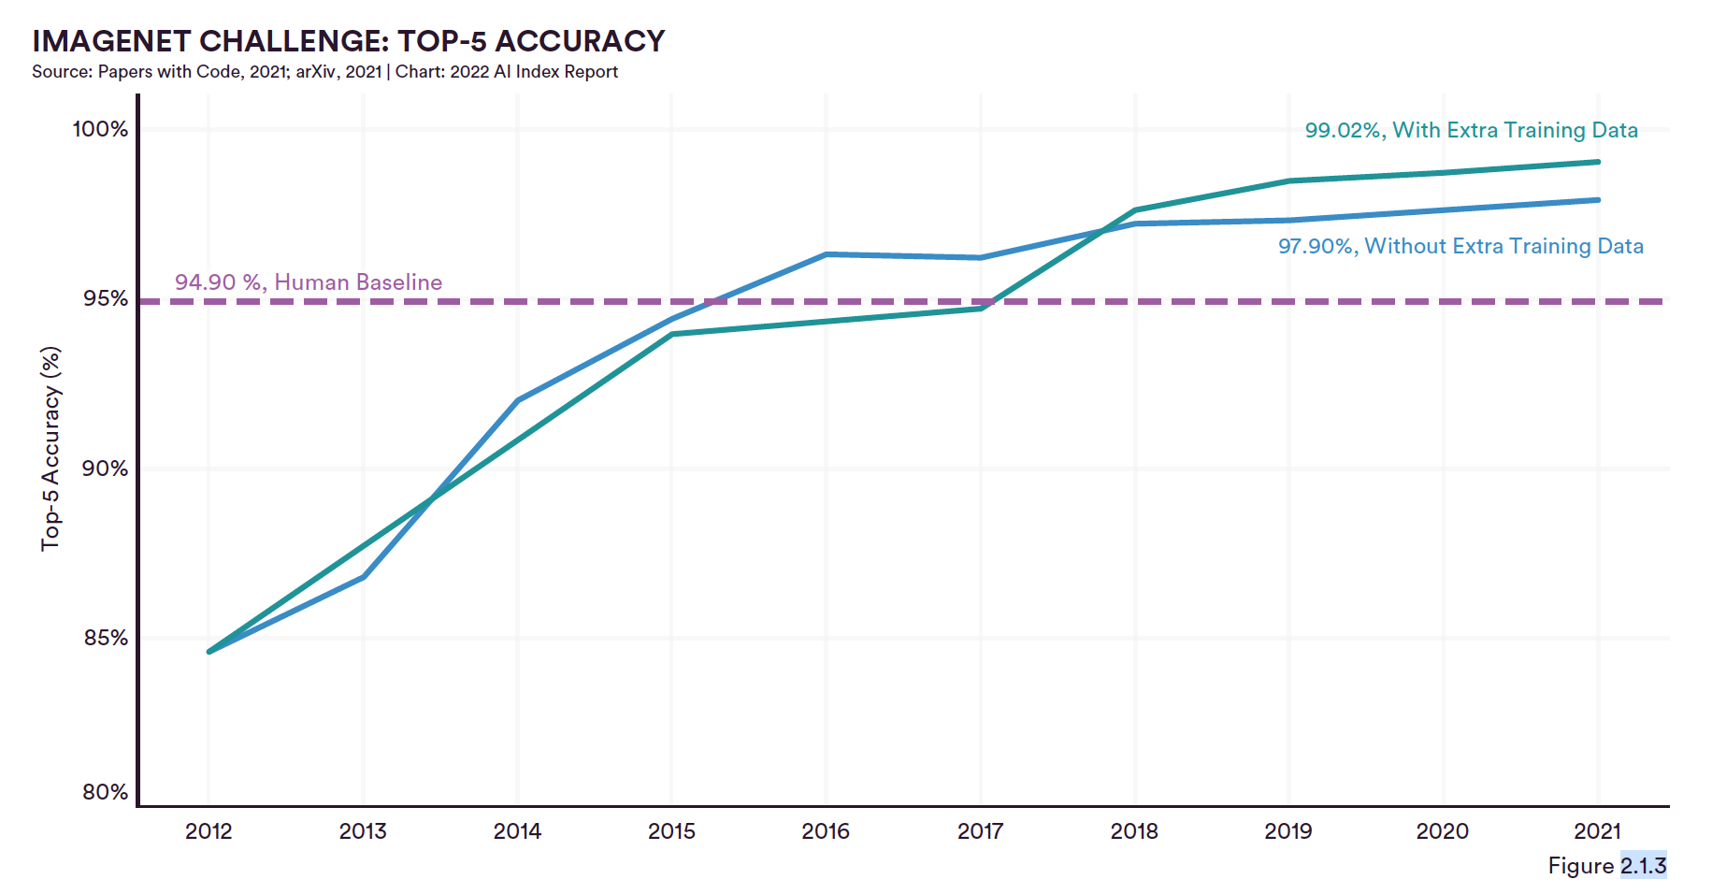
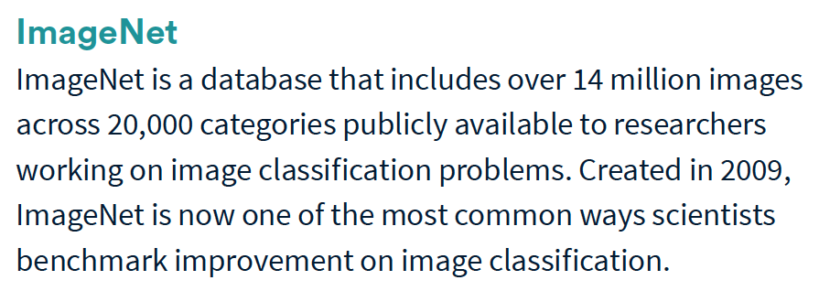

Slide 29
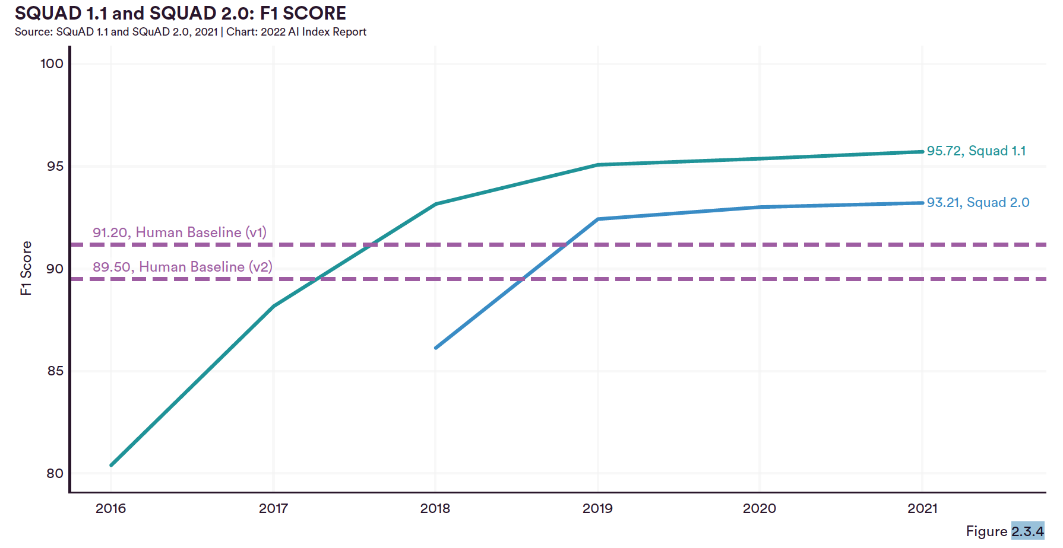
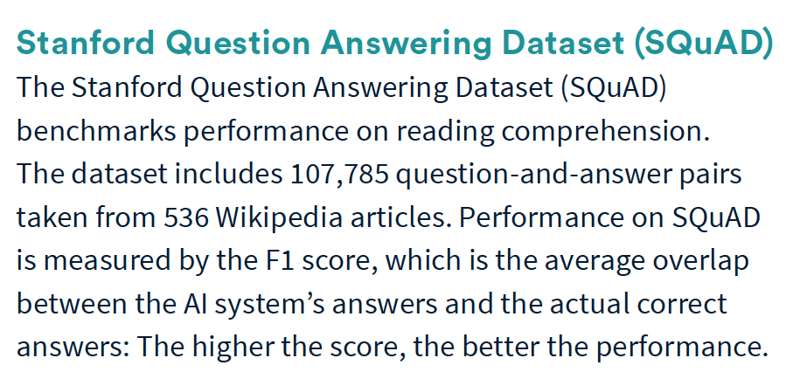

Slide 30
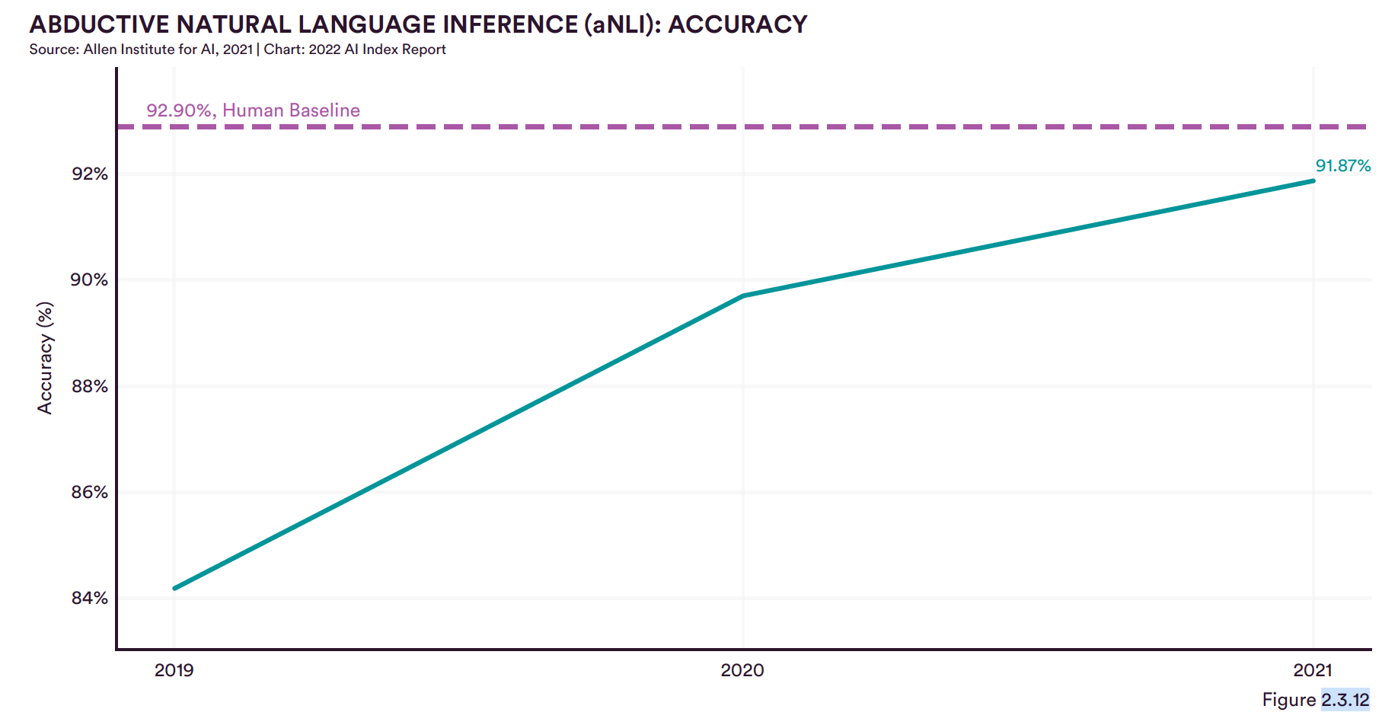

Slide 31
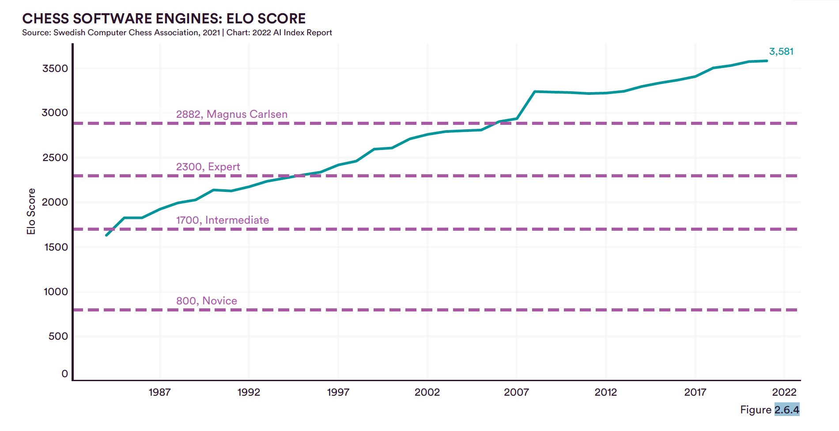

Slide 32
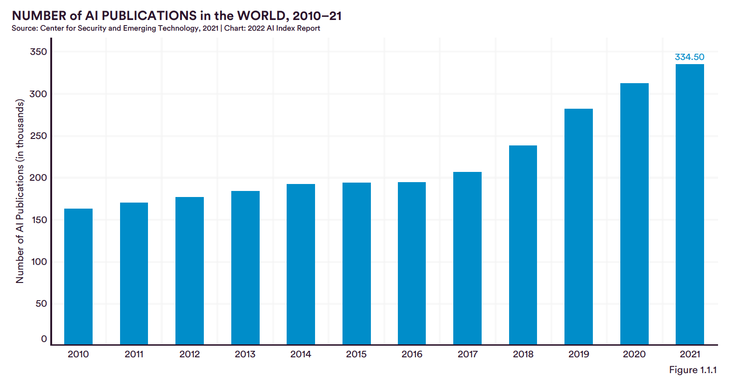

Slide 33
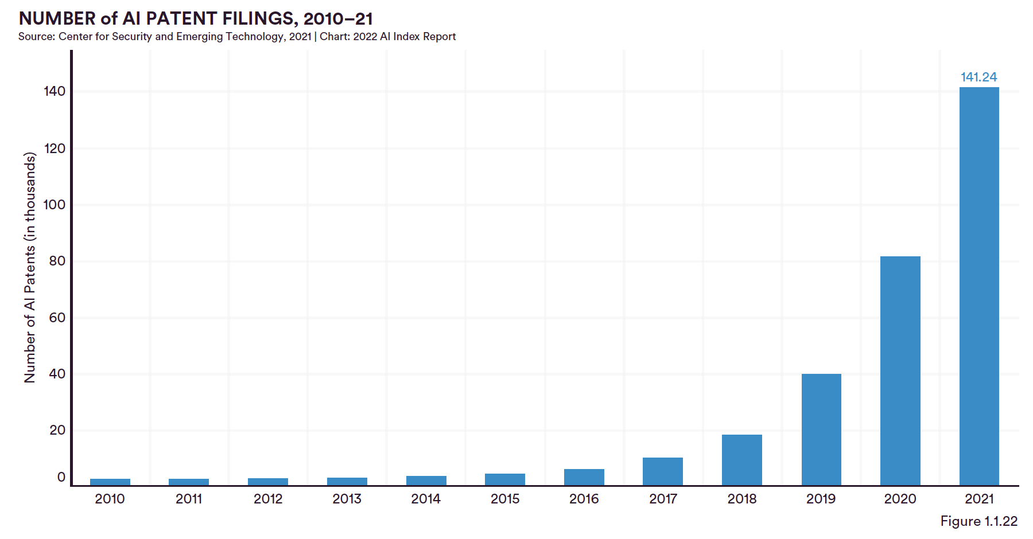
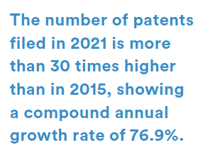

Slide 34
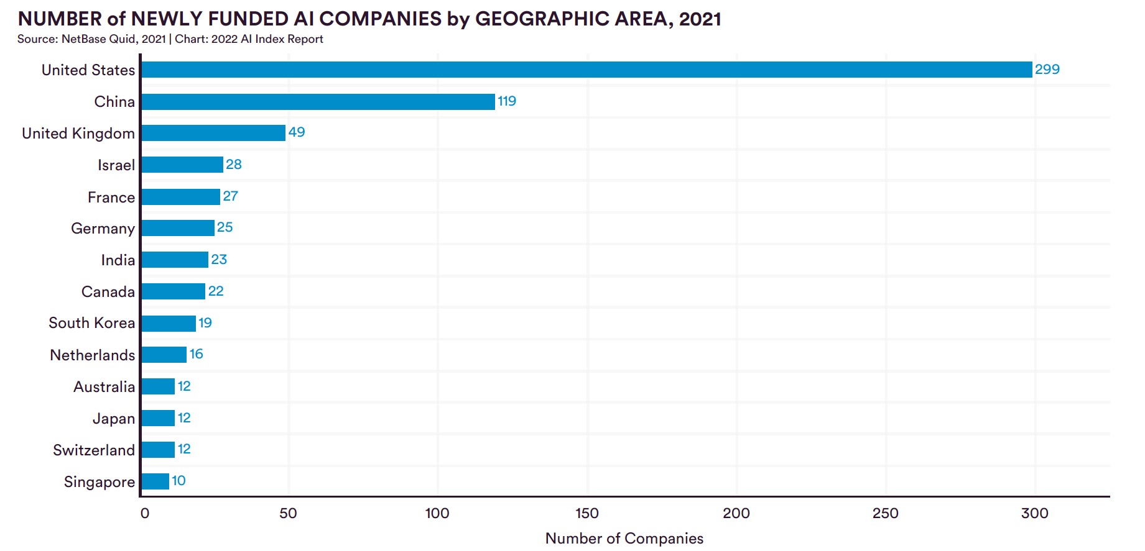
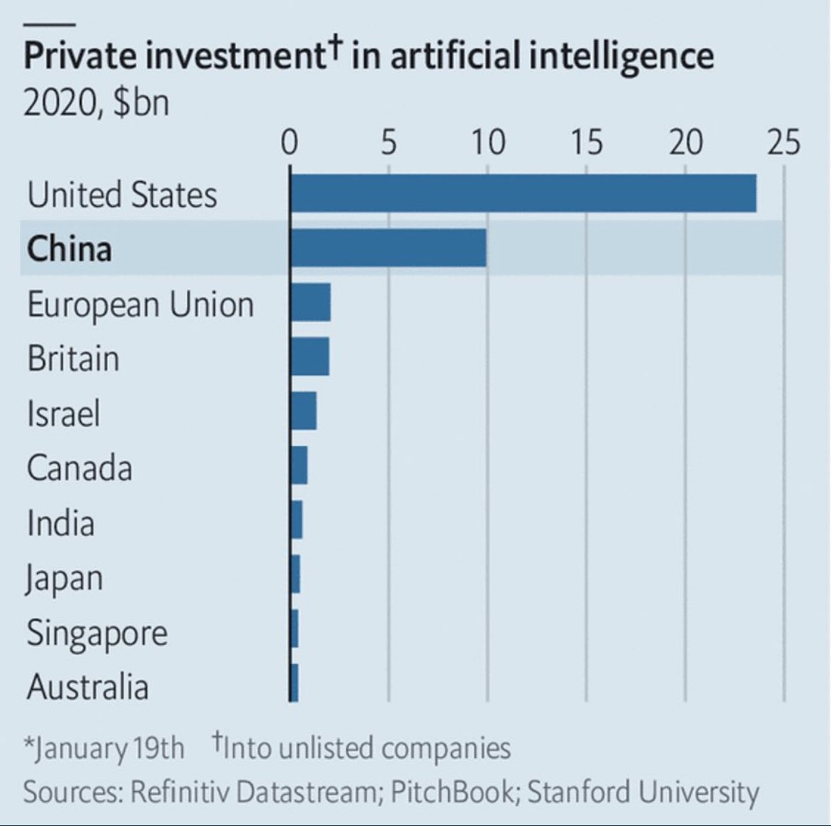

Slide 35
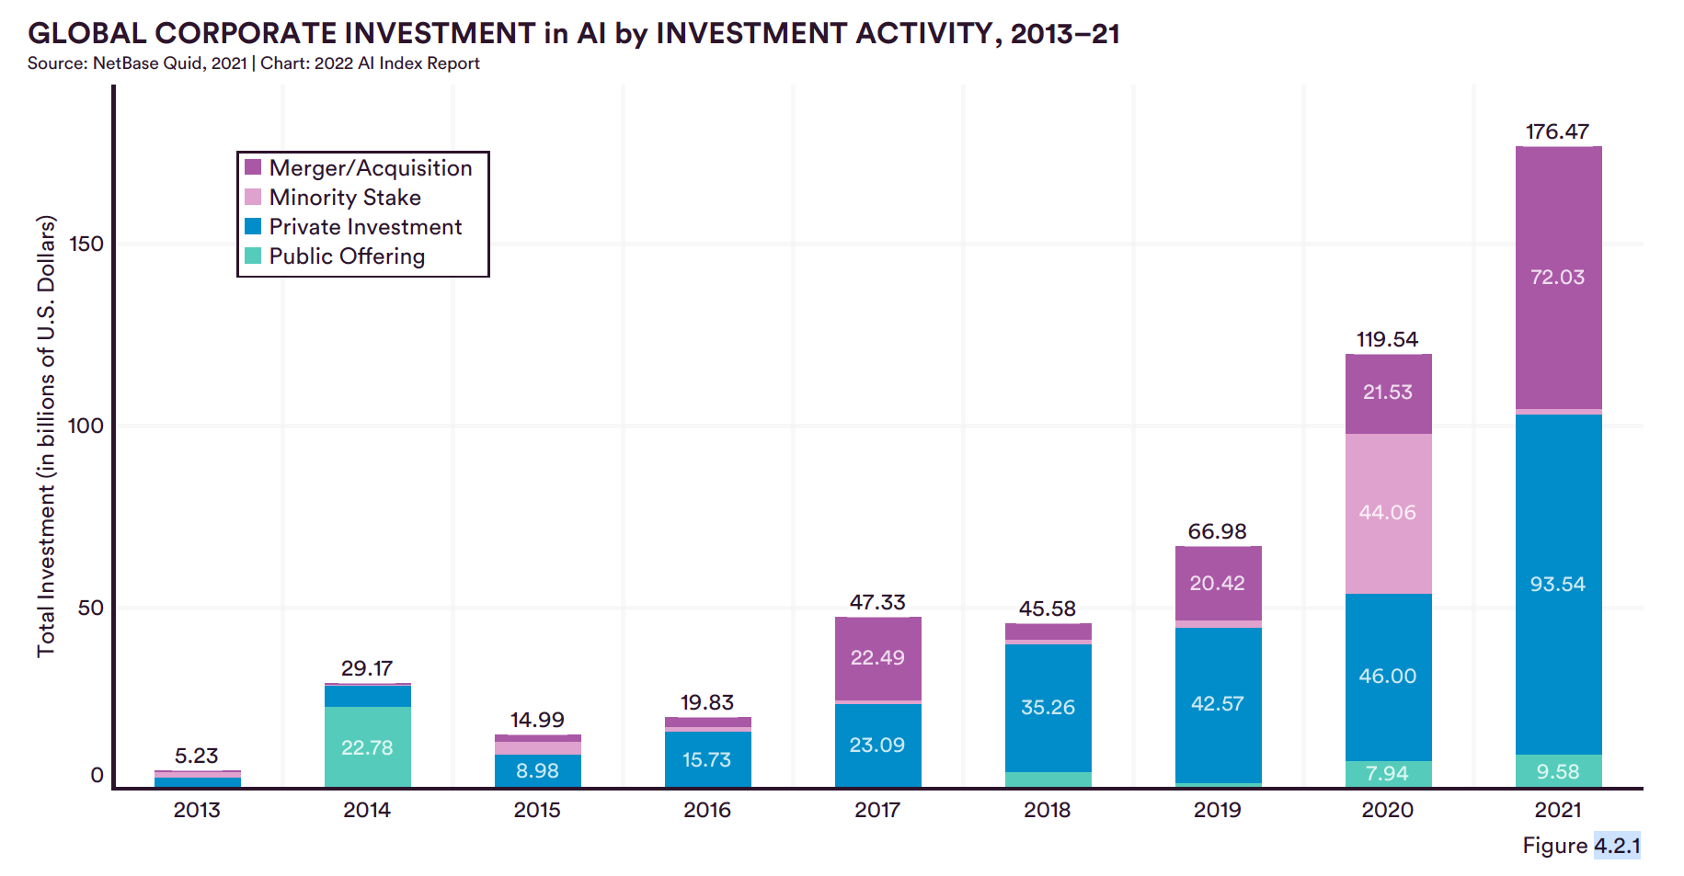

Slide 36
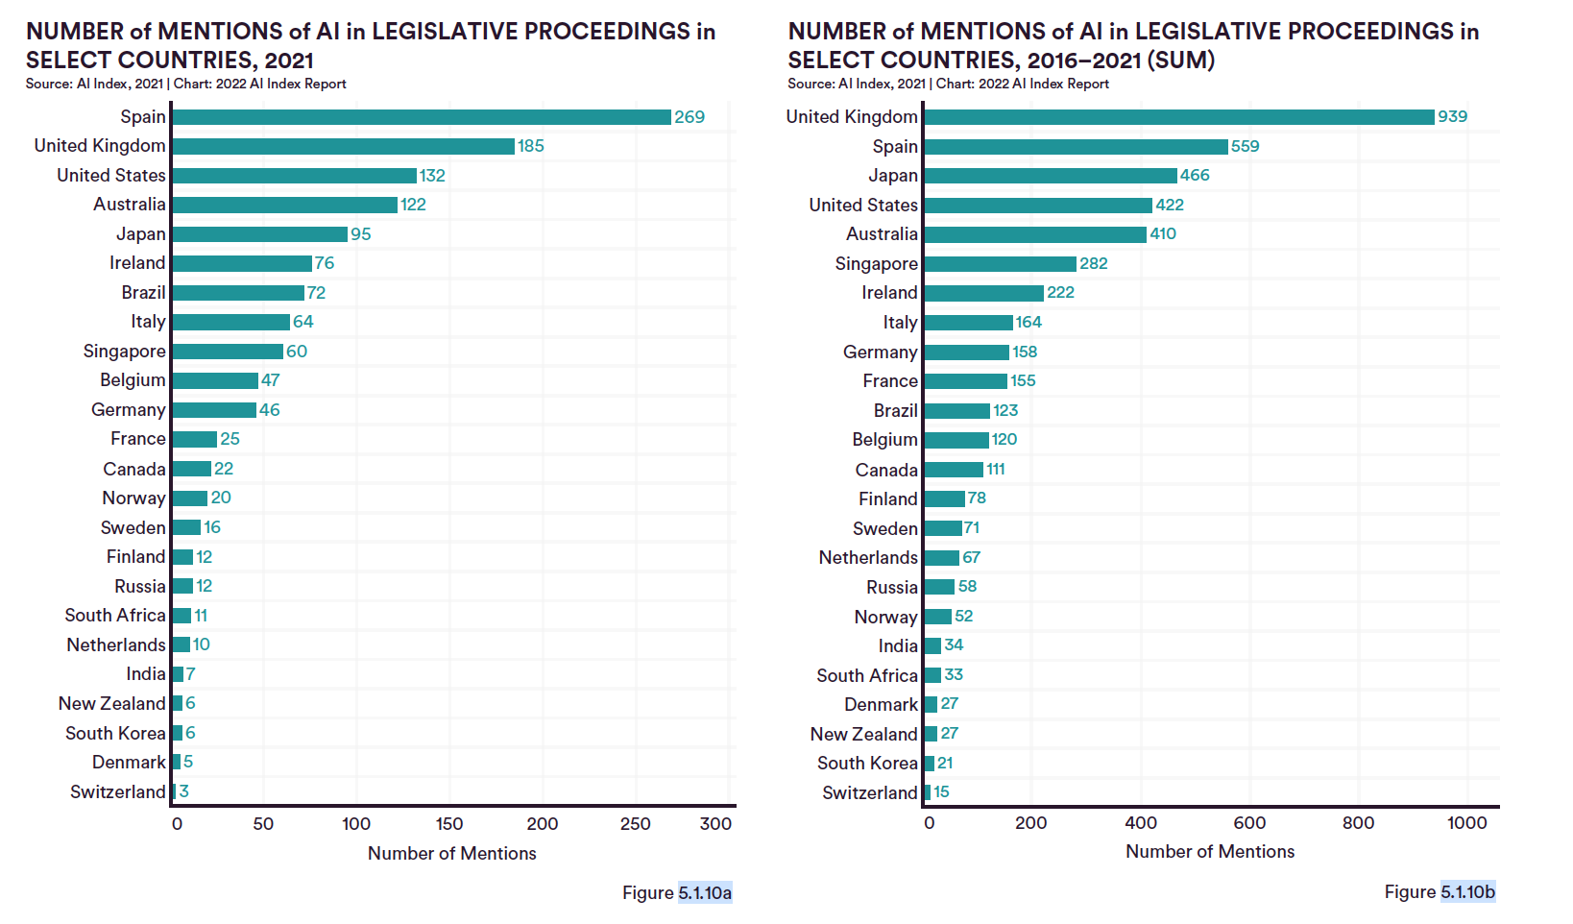

Slide 37
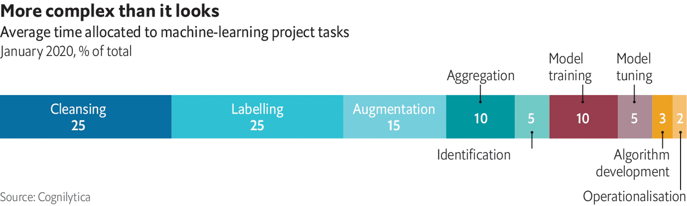
ML Projects remain Challenging
Data issues are one of the most common sticking-points in real AI projects
Up to 80% of project time is spent on the data and < 20% on ML models!
https://www.economist.com/technology-quarterly/2020/06/11/for-ai-data-are-harder-to-come-by-than-you-think

Slide 38
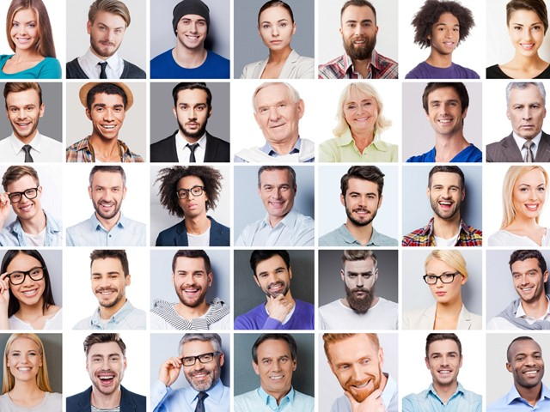
Datasets Often Contain Inherent Bias
In 2019 America’s National Institute of Standards and Technology tested nearly 200 facial recognition algorithms and found that many were significantly less accurate at identifying black faces than white ones.
The problem may reflect a preponderance of white faces in their training data. A study from IBM, published in 2019 found that over 80% of faces in three widely used training sets had light skin.
https://eandt.theiet.org/content/articles/2019/06/microsoft-quietly-takes-down-huge-facial-recognition-database/

Slide 39

Training of Large ML Models is Energy Intensive
In 2019 researchers at Uni. Amherst estimated that training one version a big language model, could cost as much as $3m.
In 2020 an algorithm capable of learning, through trial and error, how to manipulate the pieces of a Rubik's Cube using a robotic hand consumed about 2.8 gigawatt-hours of electricity in its training
Facebook’s head of AI, says that one round of training for the biggest models can cost “millions of dollars” in electricity consumption.
Researchers estimate that the training of GPT-3, which ChatGPT is partly based on, consumed 1.3 GWh, and led to emissions of more than 550 tons of carbon dioxide equivalent
https://www.wired.com/story/ai-great-things-burn-planet/
https://www.wired.com/story/the-generative-ai-search-race-has-a-dirty-secret/

Slide 40
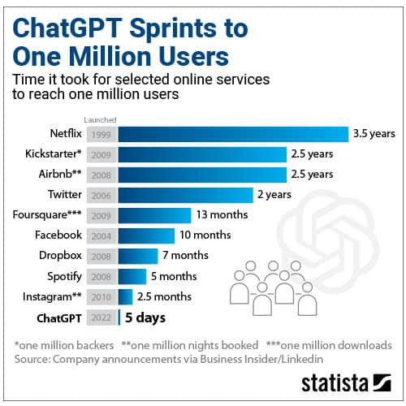

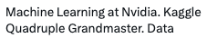
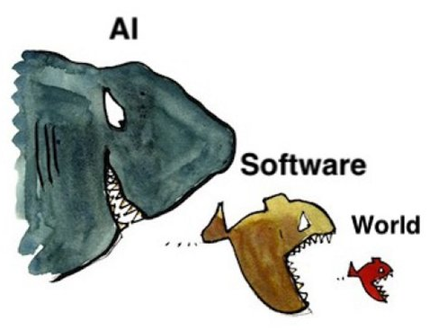
We are at a Turning Point in the History of AI/ML

Slide 41
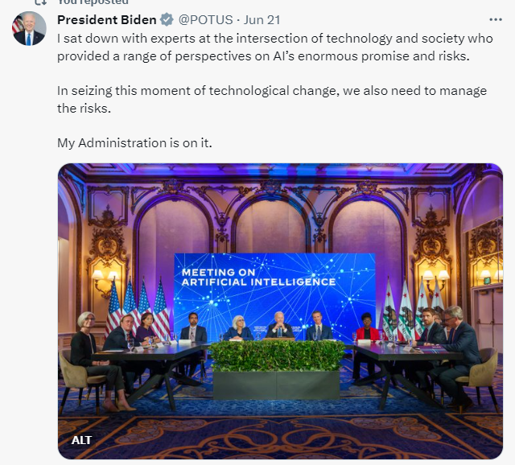
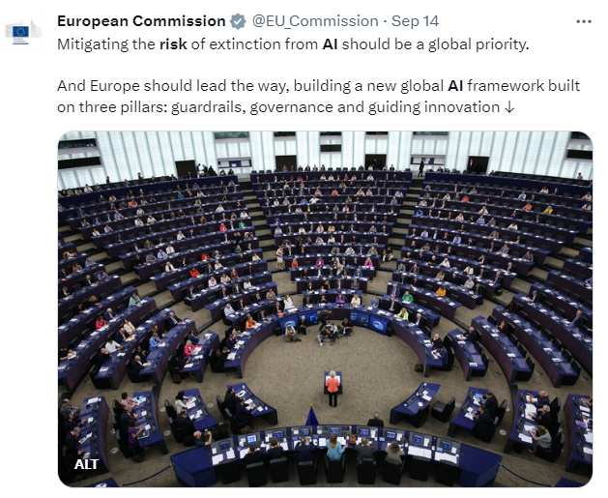
Brings risks as well as opportunities

Slide 42
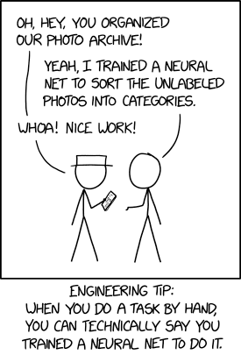
Recap of Today’s Lecture
Machine Learning in the Context of Artificial Intelligence (AI)
The Connectionists: Artificial Neural Networks (ANN’s), Machine Learning (ML) and Deep Learning (NN)
Three Pillars of Machine Learning: Data, Algorithms & Processing Power
Machine Learning Today: Progress, State-of-the-Art & Challenges
https://xkcd.com/2173/

Slide 43
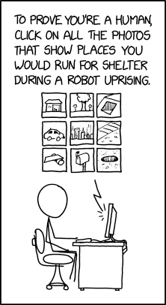
Questions to Think About
What’s the difference between AI and Machine Learning (ML)? What’s the difference between ML and Deep Learning (DL)? We had Neural Nets in the 1980s, but not DL – why not?
The average power consumption of a typical adult is 100 Watts and the brain consumes 20% of this making the power of the brain 20W, about the same as a light-bulb. How do you think we could get modern machine learning algorithms to work at this level of efficiency?
Deep Learning (DL) can learn from large amounts of data to automate cognitive tasks normally requiring a human. For example we can train a DL algorithm to screen CVs for selecting job candidates. Can you think of any negative consequences of this?
https://xkcd.com/2228/

Slide 44

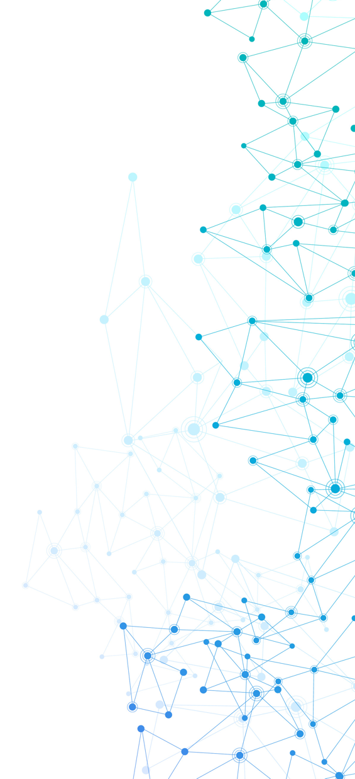
Thank you! Any Questions?
Dr. Donnacha Daly
Head of Bachelor Program in Artificial Intelligence & Machine Learning
Member of the Algorithmic Business (ABIZ) Research Lab
Lucerne University of Applied Sciences and Arts
School of Computer Science & Information Technology
donnacha.daly@hslu.ch | hslu.ch/bachelor-ai | www.abiz.ch

